Slide 1
Secure Communications & Steganography
Week 6 - Mike Wong
Week 7 - Alex Duarte

Slide 2
Secure Communications (Examples)
SSL, Online Shopping
Email/Messaging encryption
SSH, SFTP, SCP
VPN (Personal and Enterprise)
VOIP
RFID
Mesh Networks

Slide 3
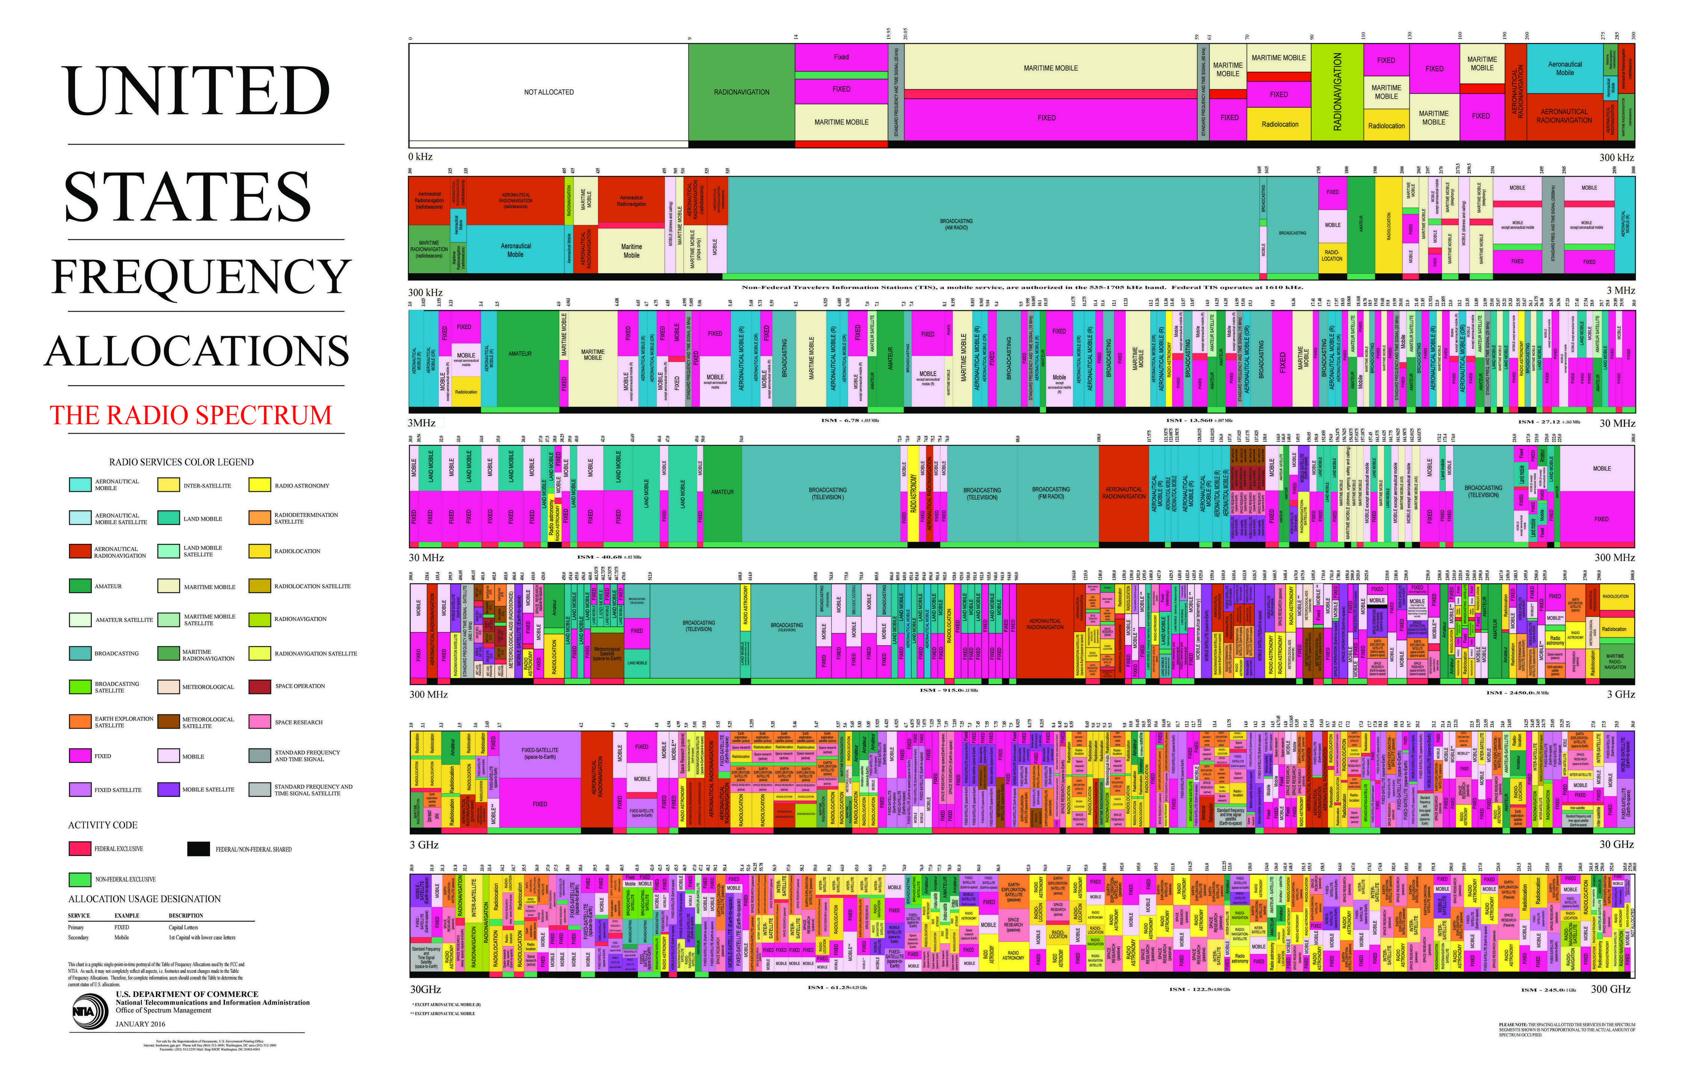

Slide 4
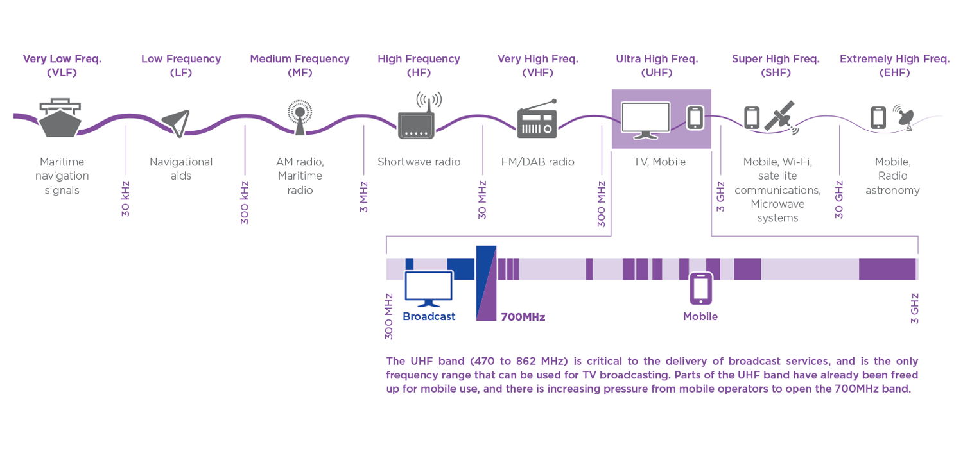

Slide 5
Focused RF Security Topics
Electronic Frontier Foundation
VPN (Personal and Enterprise)
Raspberry Pi Wireless Access Point/VPN Router
Cracking Wireless w/ Kali
RFID (POS Machines, P2PE, Physical Security)
Transportation System Discussion (PTC)

Slide 6
Electronic Frontier Foundation
Organization focused on personal privacy.
Surveillance Self Defense Guide (SSD.EFF.ORG)
Secure Communication Recommendations
Metadata – Data Collection
Mobile Phones – Location Tracking

Slide 7
EFF Communication Recommendations
End-to-End Encryption
VOIP – Polycom & RSA Security Analytics
Text & Instant Messaging – OTR Protocol
Email

Slide 8
Focused RF Security Topics
Electronic Frontier Foundation
VPN (Personal and Enterprise)
Raspberry Pi Wireless Access Point/VPN Router
Cracking Wireless w/ Kali
RFID (POS Machines, P2PE, Physical Security)
Transportation System Discussion (PTC)

Slide 9
Personal VPNs
Popularity Gained with Ruling on Net Neutrality
Used for:
Reducing Exposure of Personal Data
Circumventing Censorship
Bypassing Geo-Blocked Services (e.g. Netflix)
Obscuring a Hacker's Network Trail (Geo-Spoofing)

Slide 10


Netflix Comparison
VPN ON
VPN OFF

Slide 11
Enterprise VPNs
Becoming More Difficult to Secure
Used for:
Site to Site VPN (aka Branch VPN)
Remote Access
Recommendations
Avoid Site to Site VPN if Possible
For Remote Access – Implement MFA, No Split Tunneling, AV Version Checking, No BYOD, Deploy Certificate Based System

Slide 12
Focused RF Security Topics
Electronic Frontier Foundation
VPN (Personal and Enterprise)
Raspberry Pi Wireless Access Point/VPN Router
Cracking Wireless w/ Kali
RFID (POS Machines, P2PE, Physical Security)
Transportation System Discussion (PTC)

Slide 13
Personal VPN Deployment
Download Opera Browser (Built in VPN)
Purchase VPN Product (Install Agents/Apps on Devices)
Implement OpenVPN (Free)

Slide 14
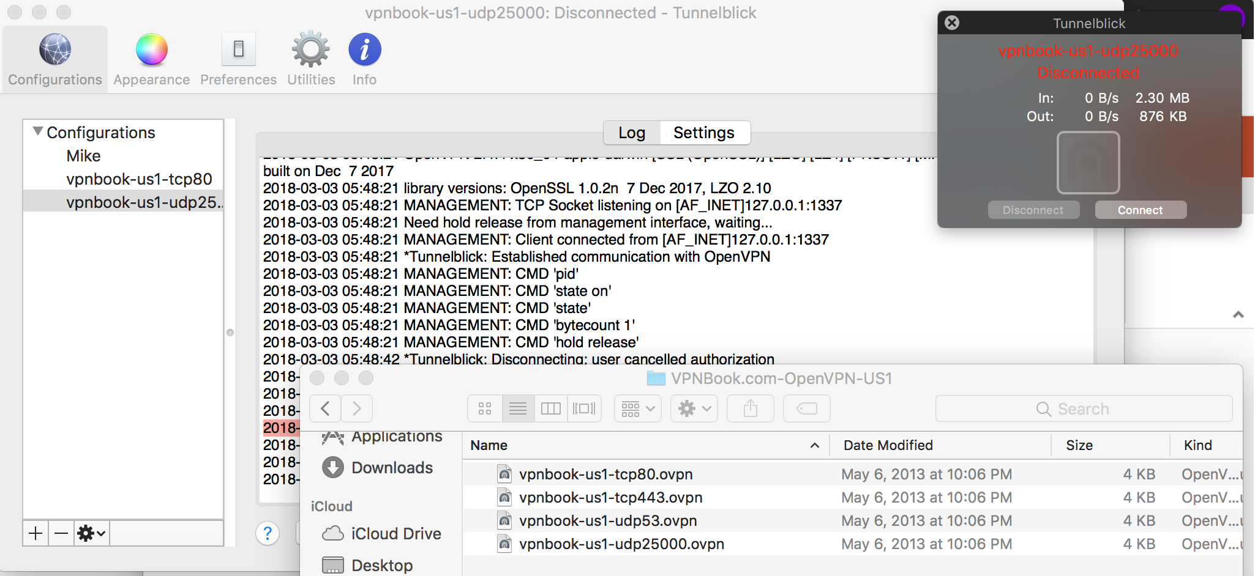
OpenVPN Implementation

Slide 15
Raspberry Pi Project Requirements
Raspberry Pi 3 (Preferred)
Monitor w/ HDMI
RJ45 Internet Connection
USB Keyboard Mouse
Micro SD Card (Over 8Gb)
Lots of Patience and Time

Slide 16
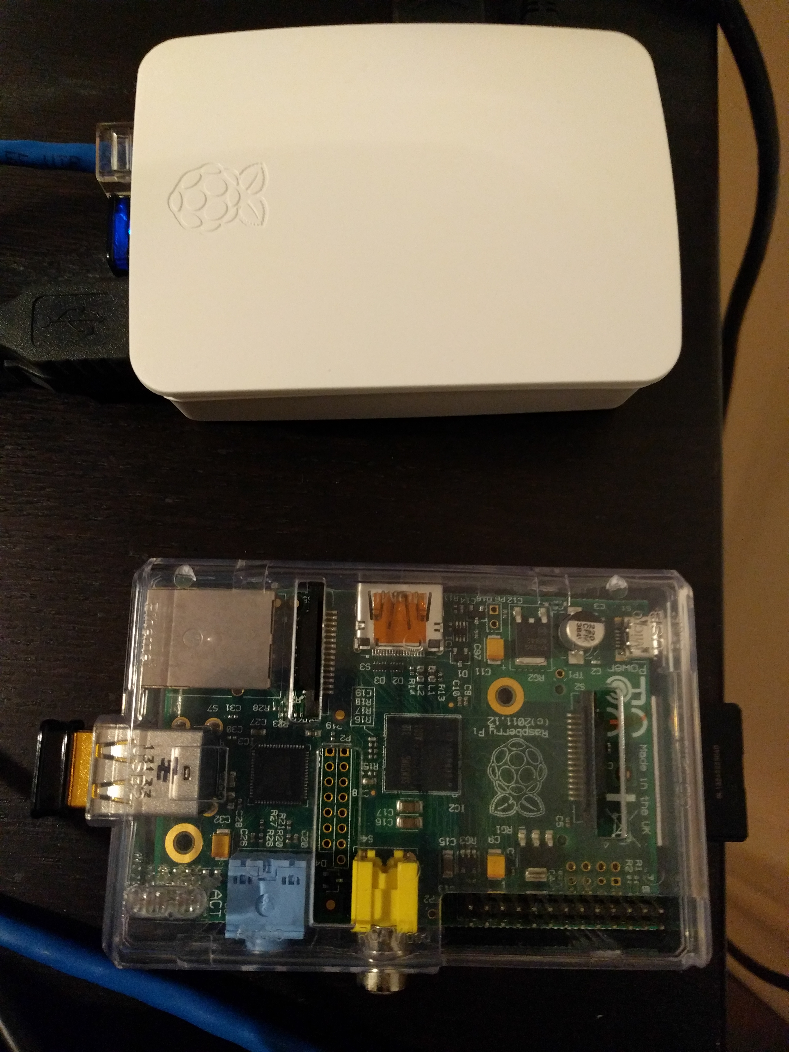
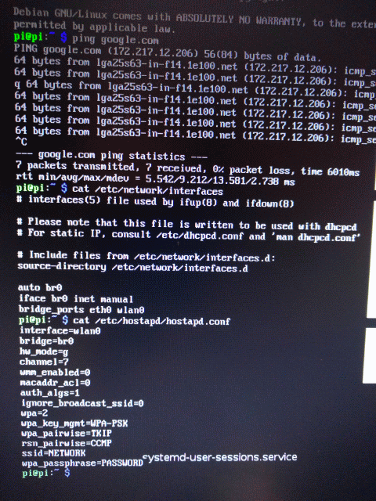
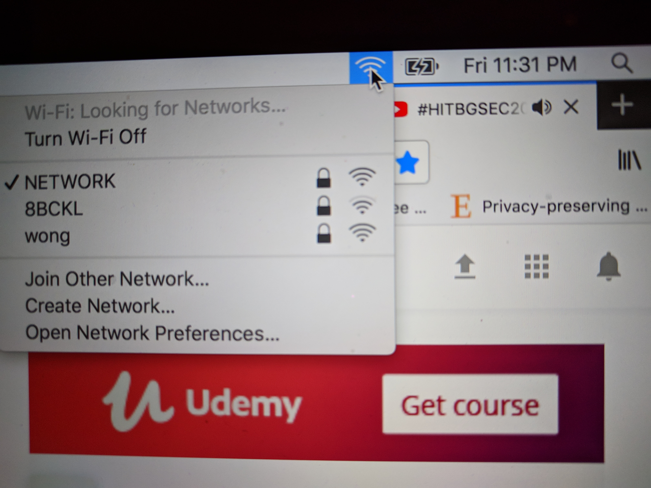
Raspberry Pi Project

Slide 17
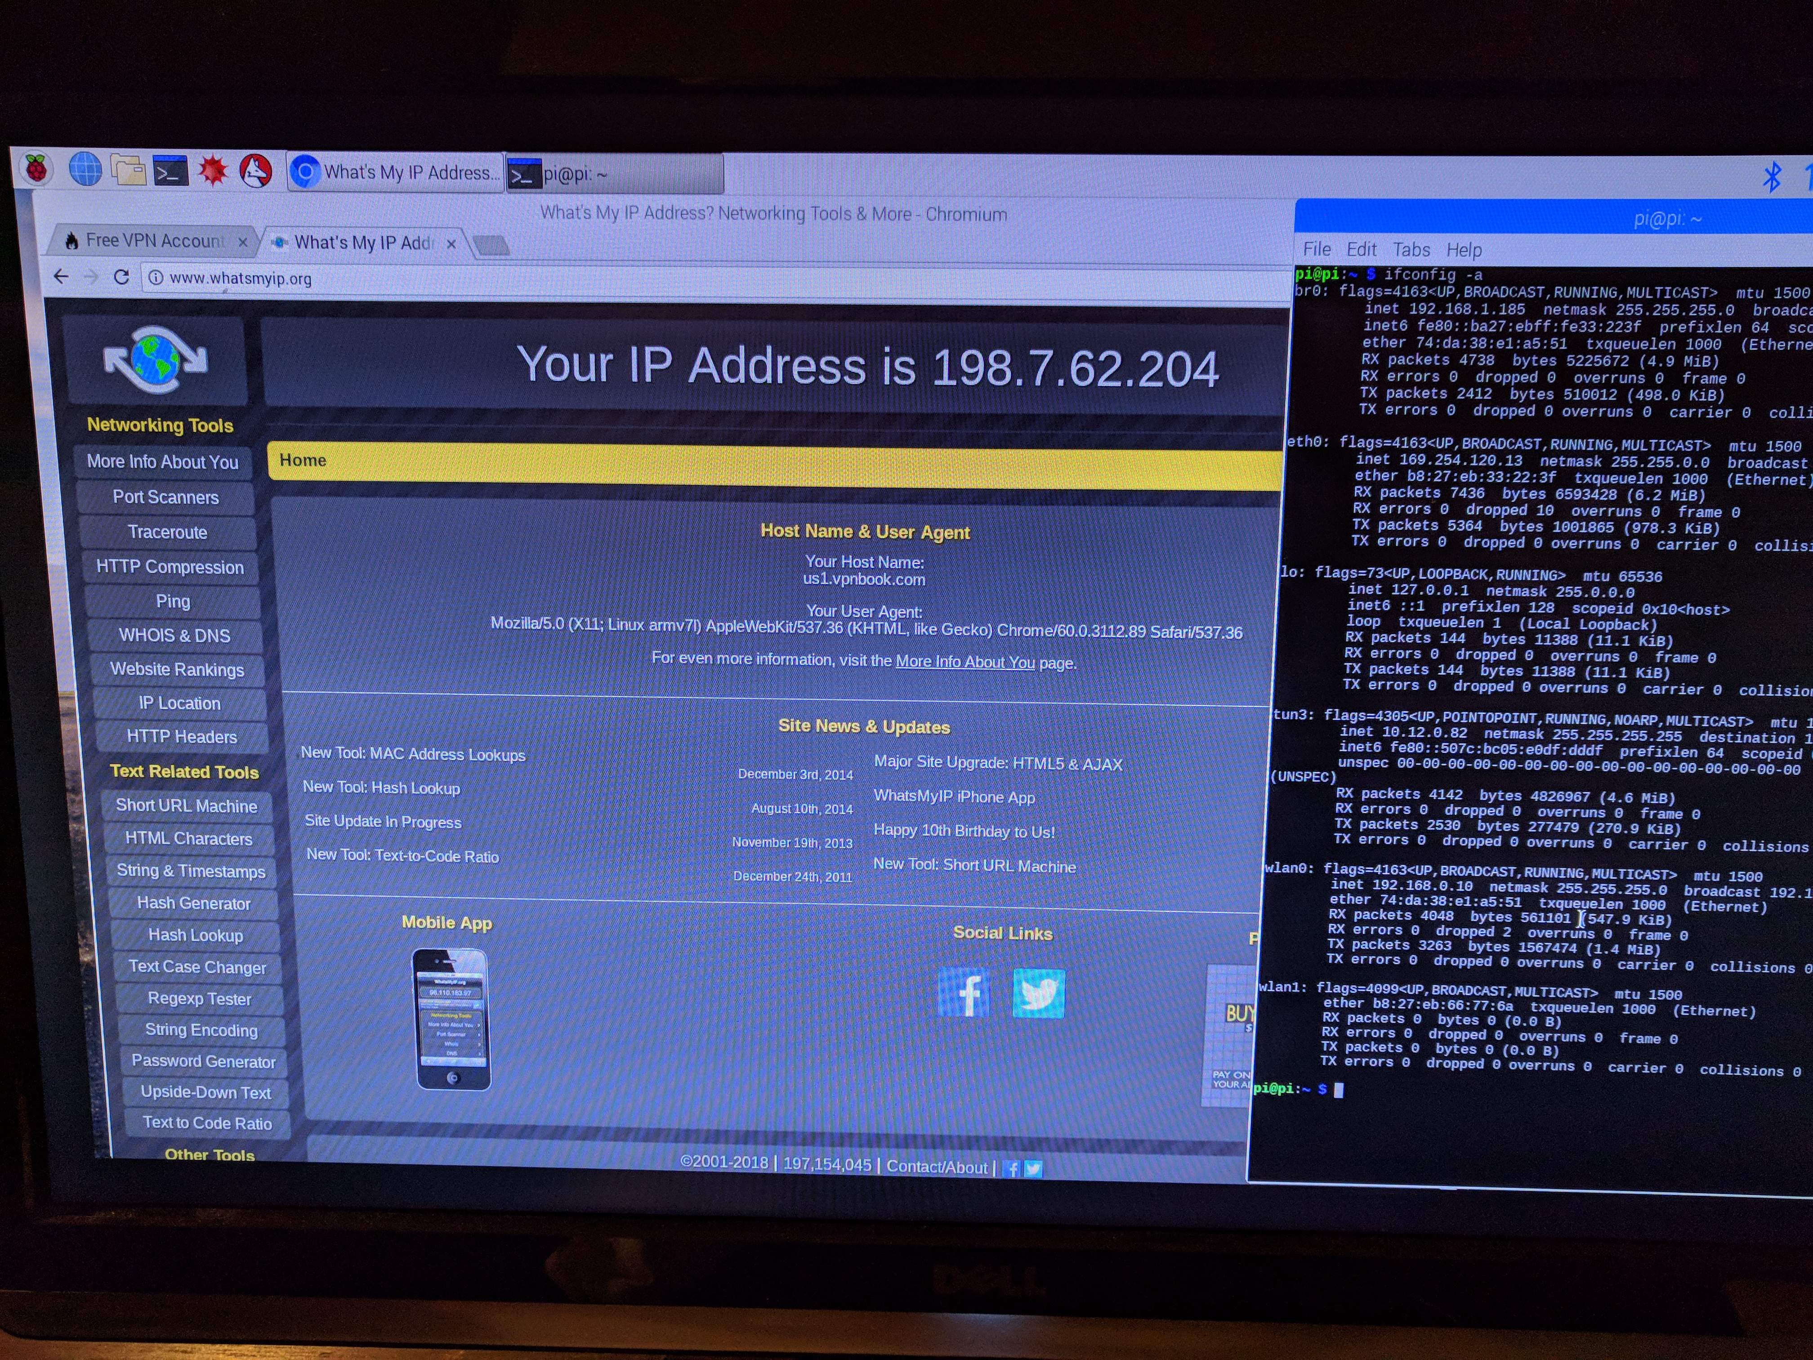
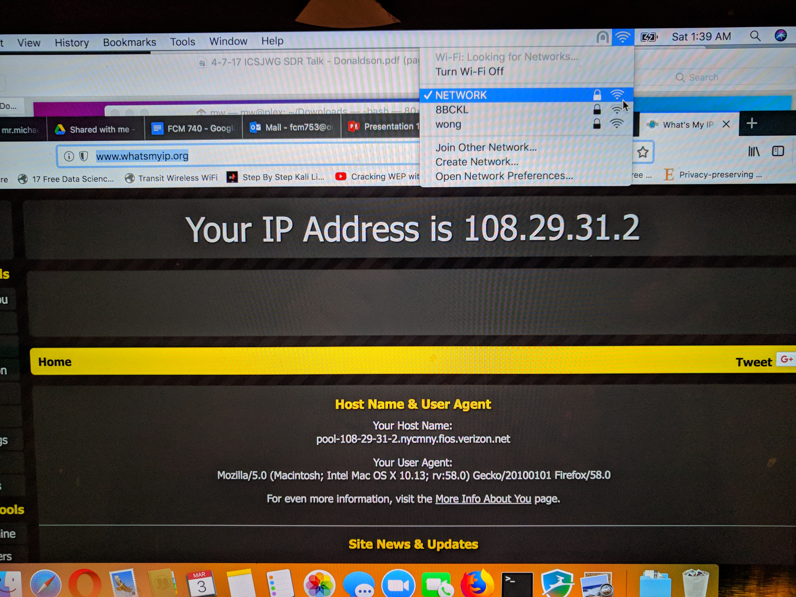
Raspberry Pi Results

Slide 18

BREAK TIME

Slide 19
Focused RF Security Topics
Electronic Frontier Foundation
VPN (Personal and Enterprise)
Raspberry Pi Wireless Access Point/VPN Router
Cracking Wireless w/ Kali
RFID (POS Machines, P2PE, Physical Security)
Transportation System Discussion (PTC)

Slide 20

Cracking Wireless w/ Kali
Live Demonstration...

Slide 21
Focused RF Security Topics
Electronic Frontier Foundation
VPN (Personal and Enterprise)
Raspberry Pi Wireless Access Point/VPN Router
Cracking Wireless w/ Kali
RFID (POS Machines, P2PE, Physical Security)
Transportation System Discussion (PTC)

Slide 22
RFID Card Types
Active
Semi-Active
Passive

Slide 23
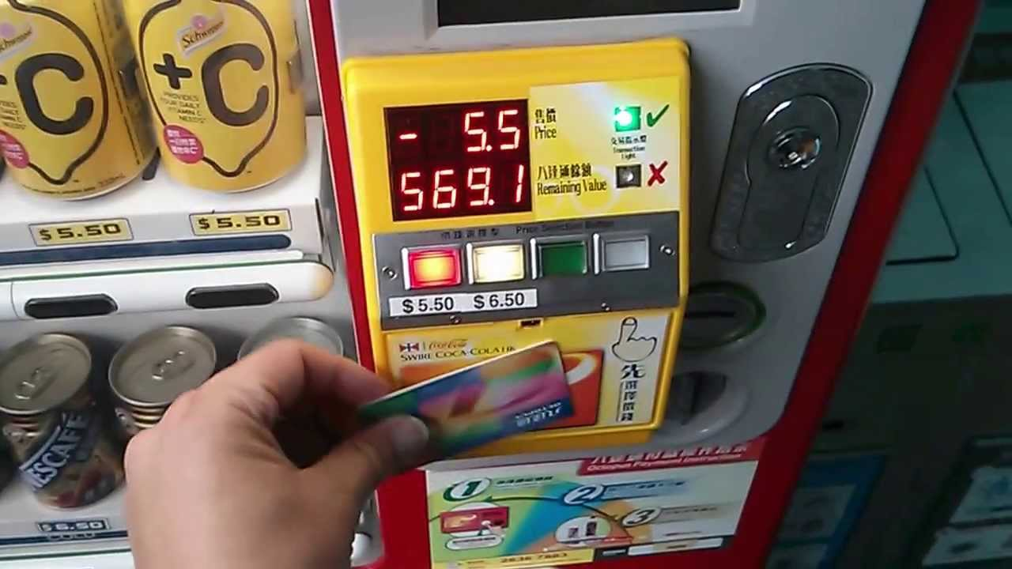
Octopus Card (Hong Kong)

Slide 24
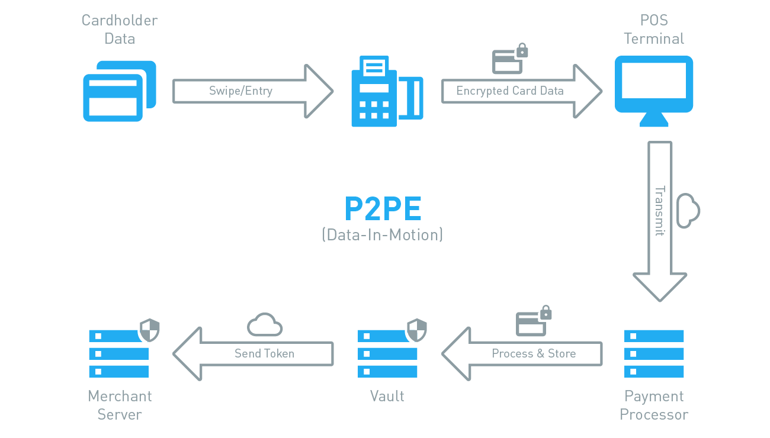
Point to Point Encryption

Slide 25
Focused RF Security Topics
Electronic Frontier Foundation
VPN (Personal and Enterprise)
Raspberry Pi Wireless Access Point/VPN Router
Cracking Wireless w/ Kali
RFID (POS Machines, P2PE, Physical Security)
Transportation System Discussion (PTC)

Slide 26
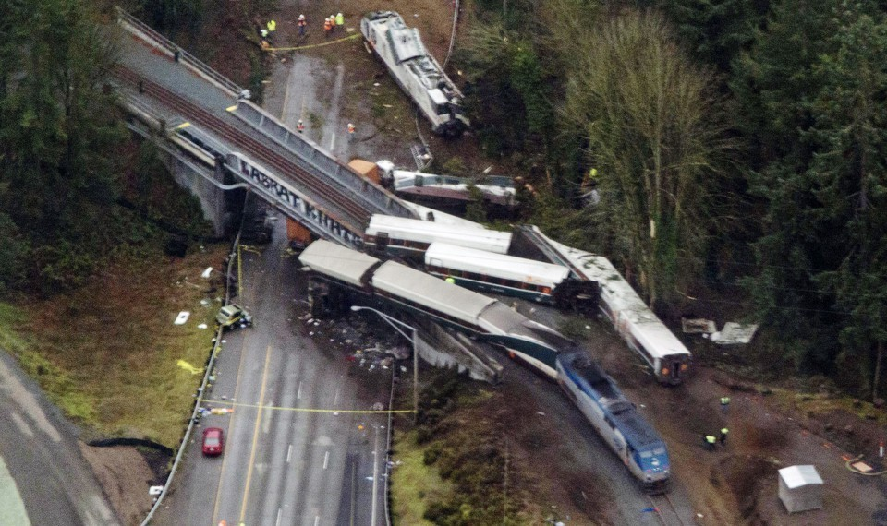
Positive Train Control
FCC Licensed Frequency
Dedicated for PTC
Vulnerabilities
Jamming
Latency
Authentication
Emerging Threat (SDR)

Slide 27
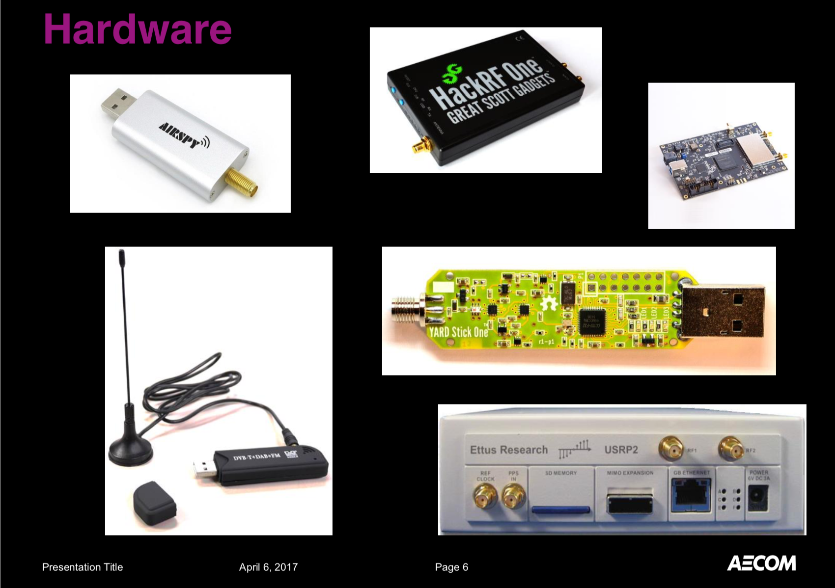
Software Defined Radio Hacking Tools

Slide 28
THANK YOU!

